Slide 1




Slide 2
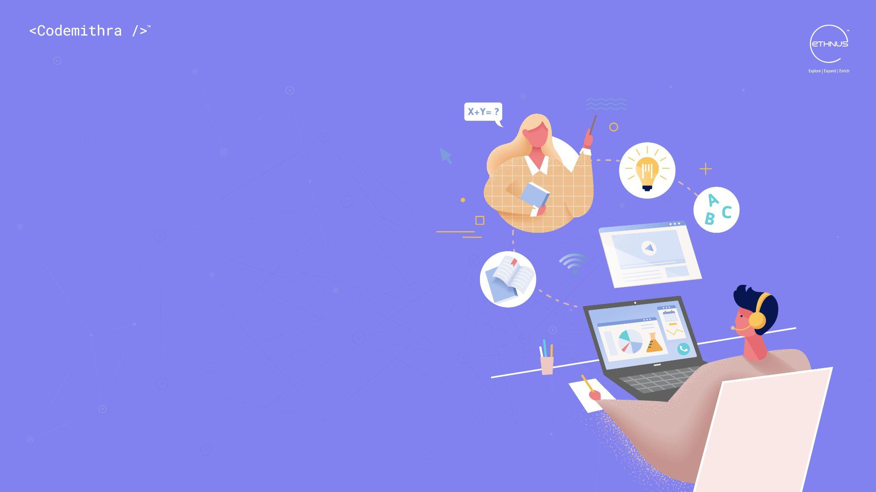
PRESENTATION SKILLS-
DESIGN OF POSTERS

Slide 3
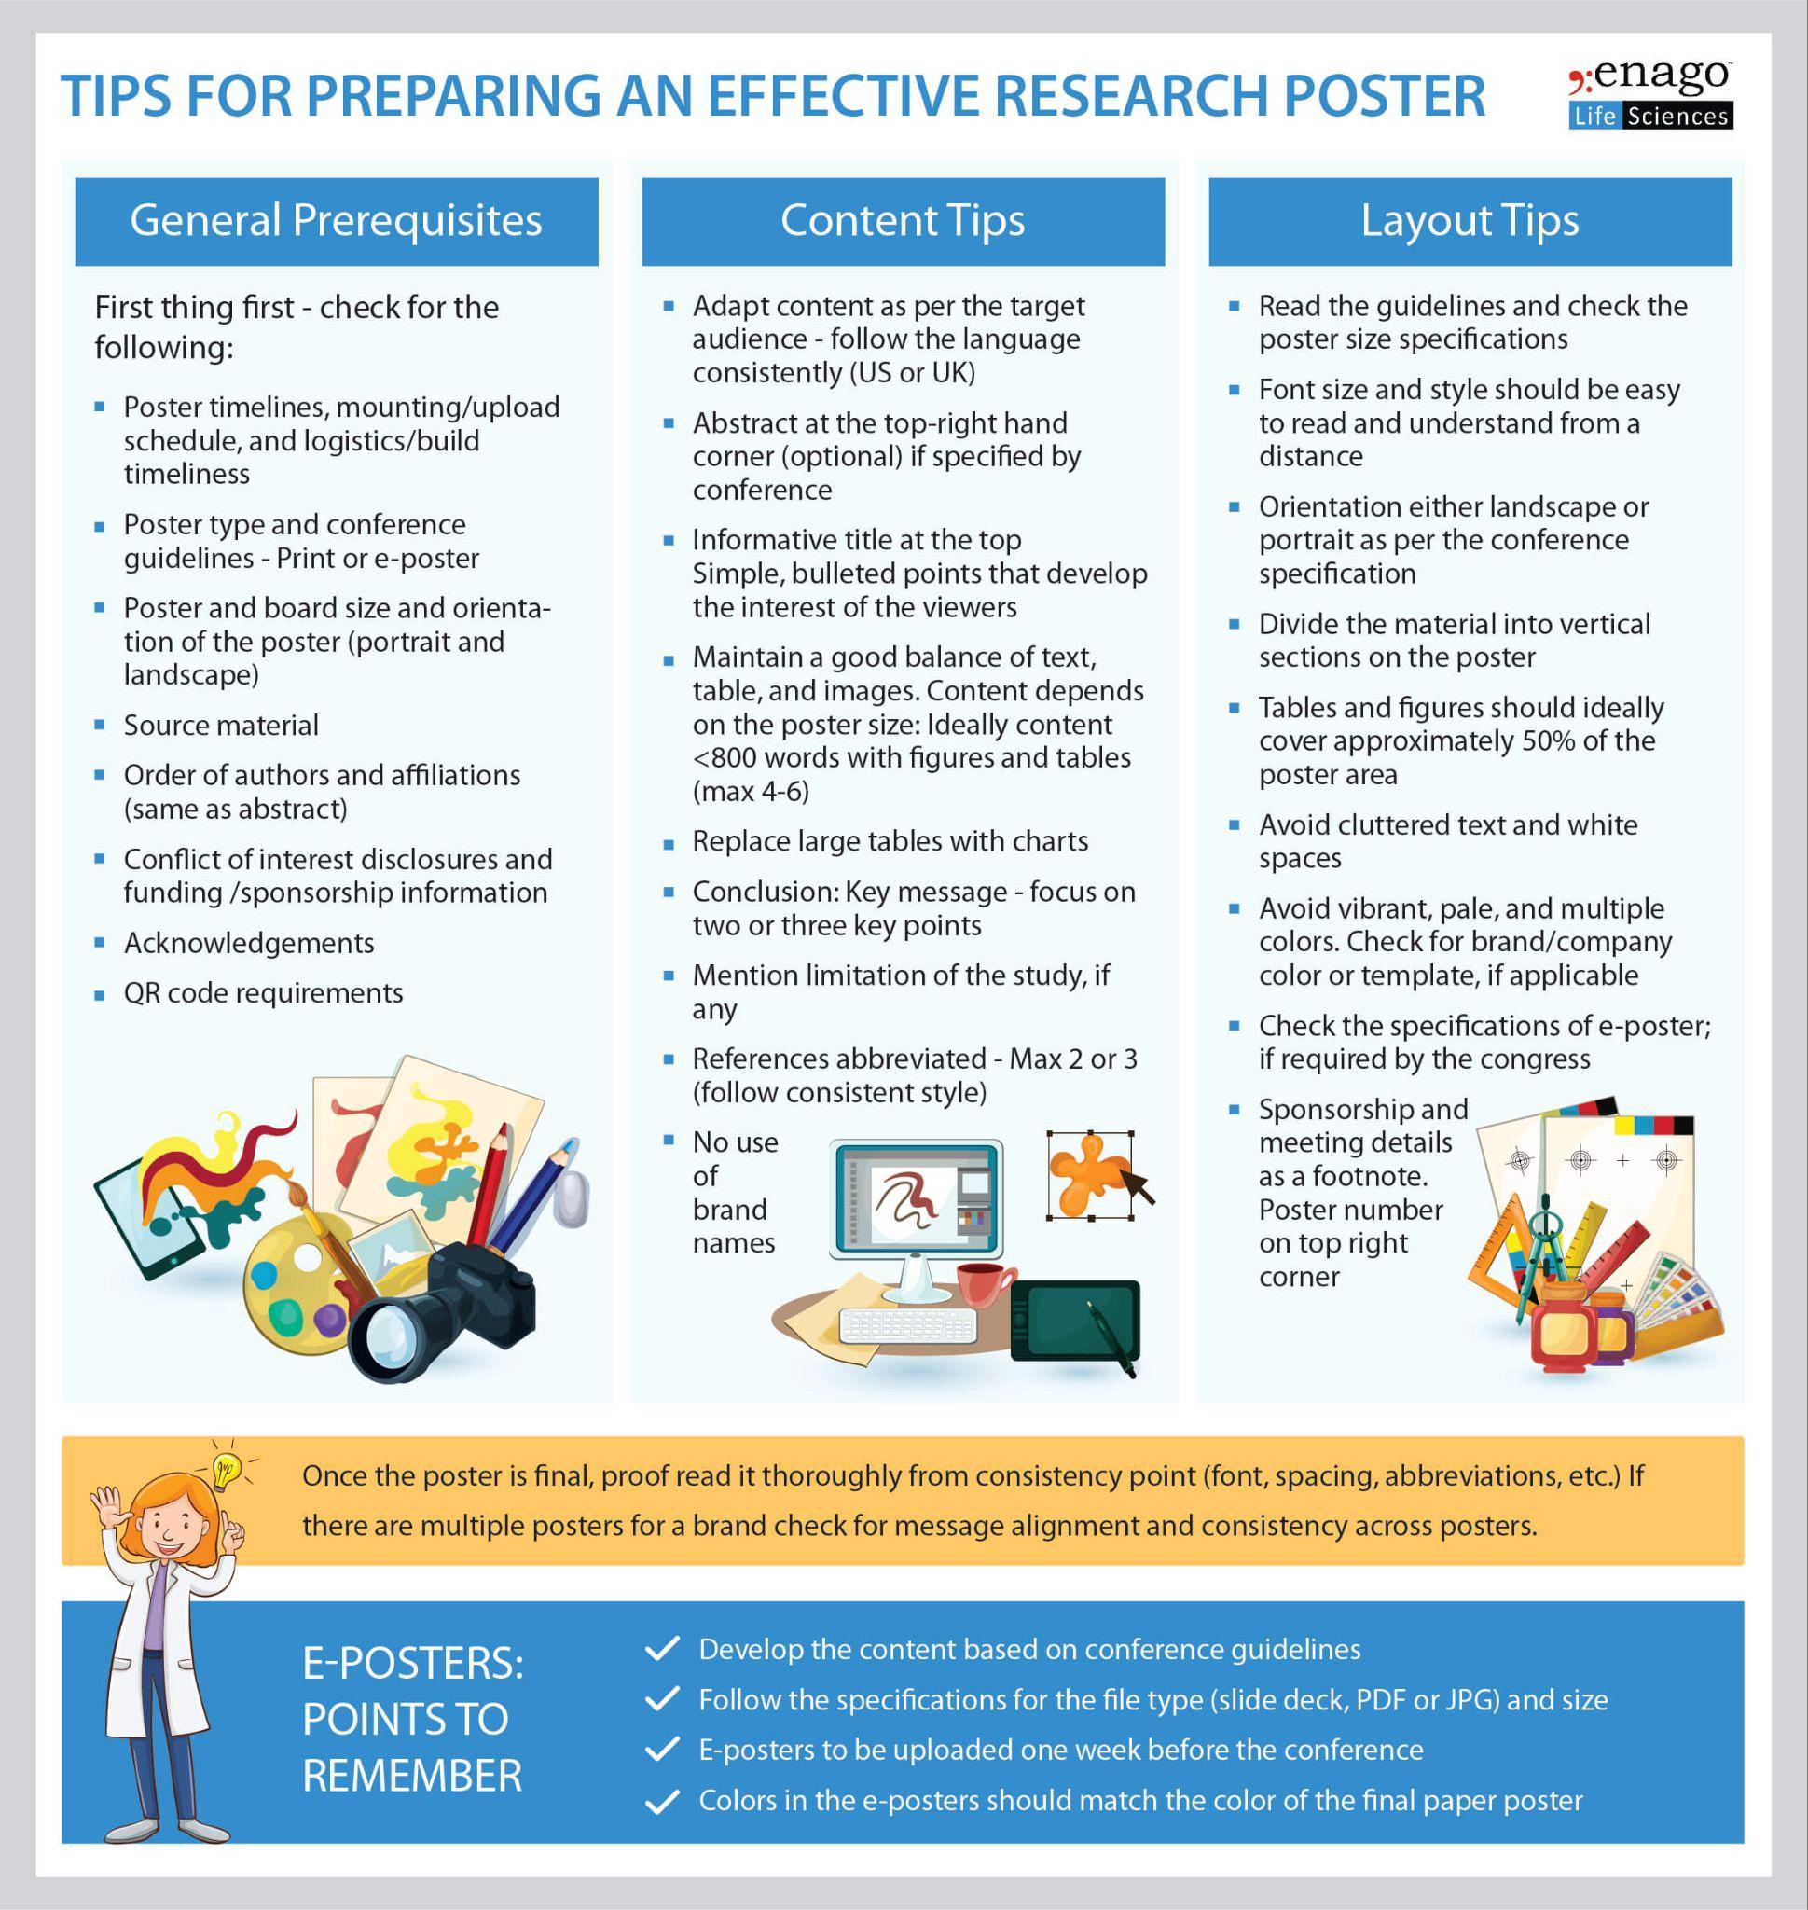
DESIGN ON SKILLS
What is a Poster Presentation?
Notes:
A poster presentation at a conference with a professional focus is the presentation of research information, typically peer-reviewed work, in the form of a paper poster that conference participants may view. A poster session is an event at which many such posters are presented. Poster sessions are particularly prominent at scientific conferences such as medical congresses. Posters are large painted pictures that are put up for decoration on certain occasions. They are mainly used in presentations as a visual aid and can be displayed on walls, screens, boards, or even handheld and explained.

Slide 4
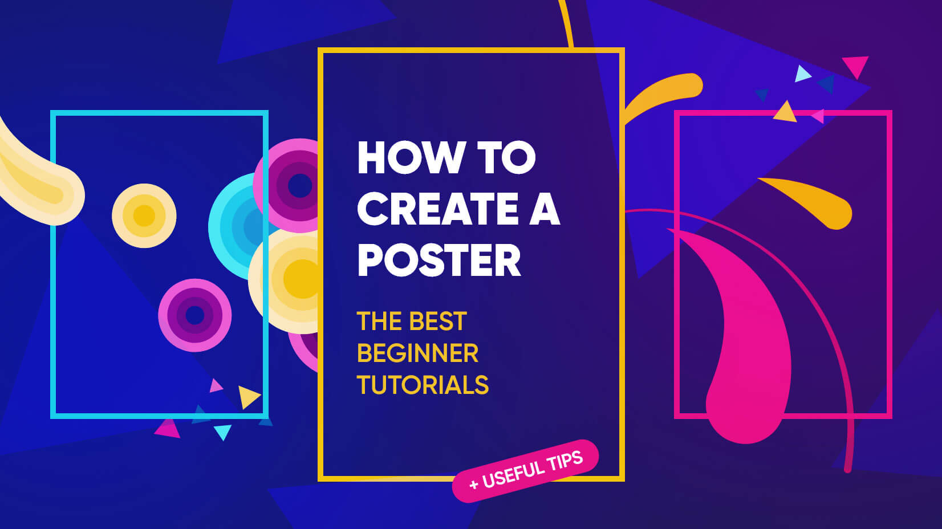
How to Create a Good Poster Design?
Notes:
Here are some tips to make a poster design:
Make it Easy to Read from a Distance:
Increase the Contrast
Consider Size and Location
Make a Mini Version
Include a Big Visual
Use Plenty of Space
Include a Call to Action
Create Focus with Typography

Slide 5
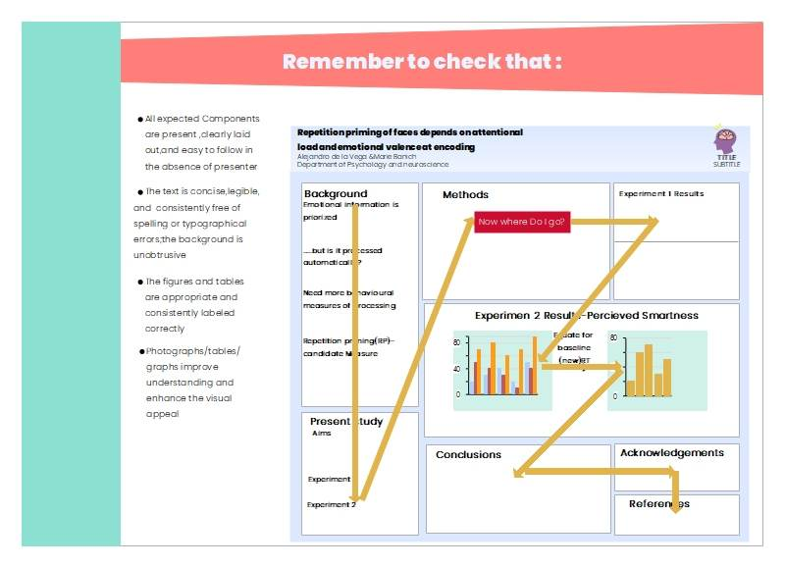
Make It Easy to Read from a Distance
Notes:
The main (and largest) text element in the design. Choose a readable typeface that is interesting and demands attention.
Details: Provide key information such as what, when, and where. This should be clear and concise, with a clear hierarchy in the text.
Fine Print: Smaller text for additional information. Keep it out of the way but accessible.

Slide 6

Increase the Contrast
Notes:
Use bold colors and type options to grab attention.
Avoid monotone color palettes with pale gradients; opt for high contrast between elements.
Consider a colored background with a full bleed to make your poster stand out.

Slide 7
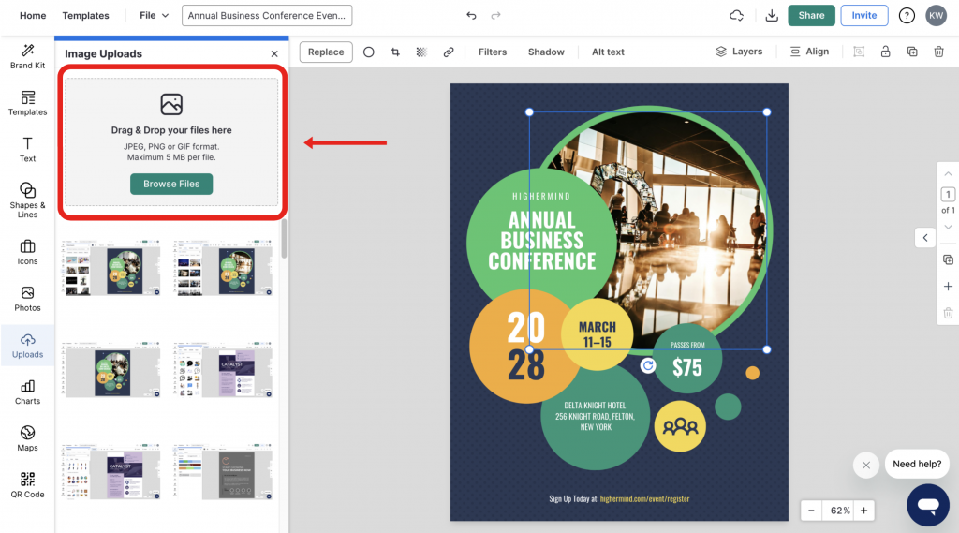
Consider Size and Location
Notes:
The poster's location influences its design choices, such as size, visual clutter around it, and whether people will appreciate the call to action.
Ensure visual contrast with the surroundings, like avoiding a green poster on a green wall.

Slide 8
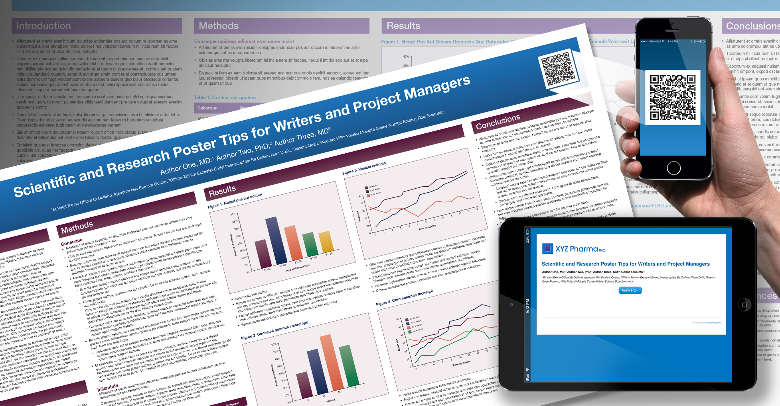
Make a Mini Version
Notes:
Create scaled-down versions for sharing on social media, postcards, or email.
Consider a "poster-version" landing page for your website.

Slide 9
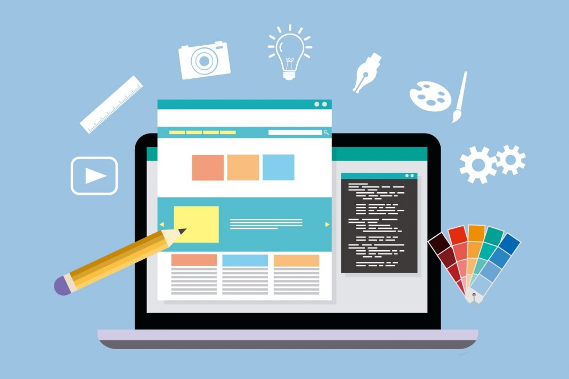
Consider One Big Visual
Notes:
Choose a dominant image, whether a photo, illustration, or text, that is readable from a distance.
Be careful with layering elements; ensure type and images have enough contrast to be independently readable.

Slide 10
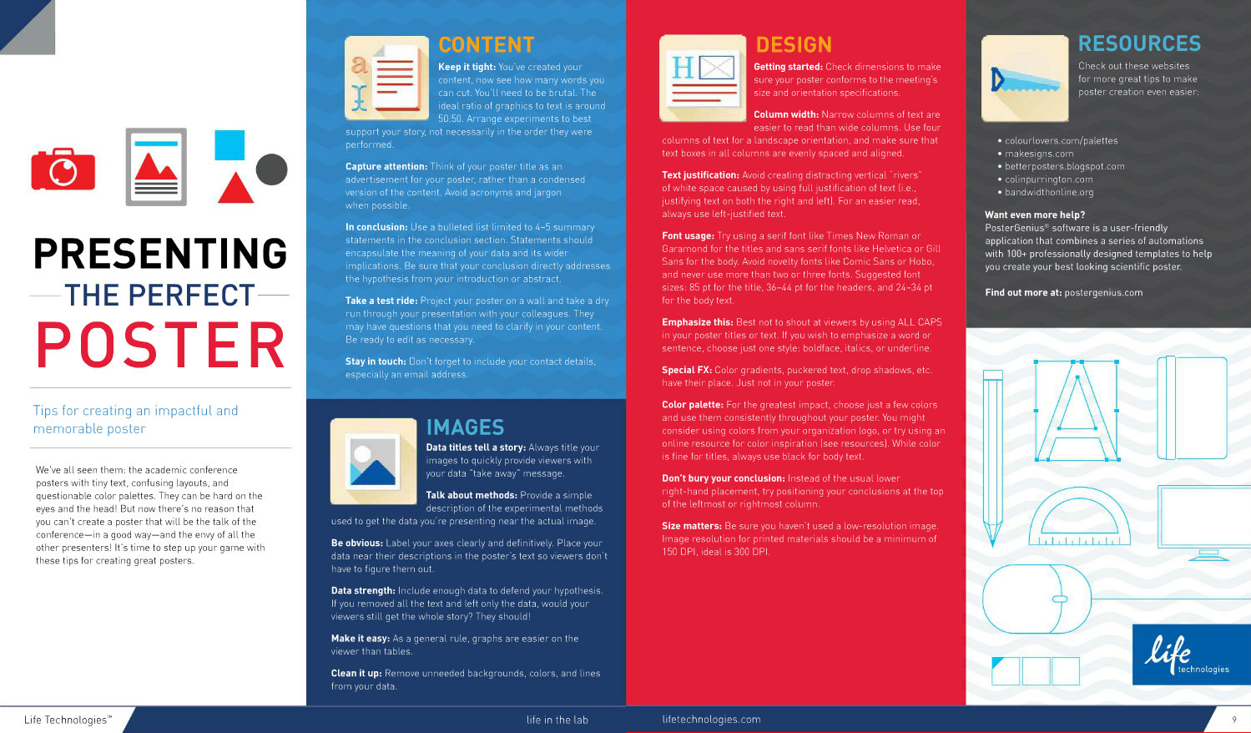
Use Plenty of Space
Notes:
Exaggerate spacing between elements to increase visual impact and readability from a distance.
Use extra space between individual letters, lines of text, around interior margins, and between different types of elements.

Slide 11
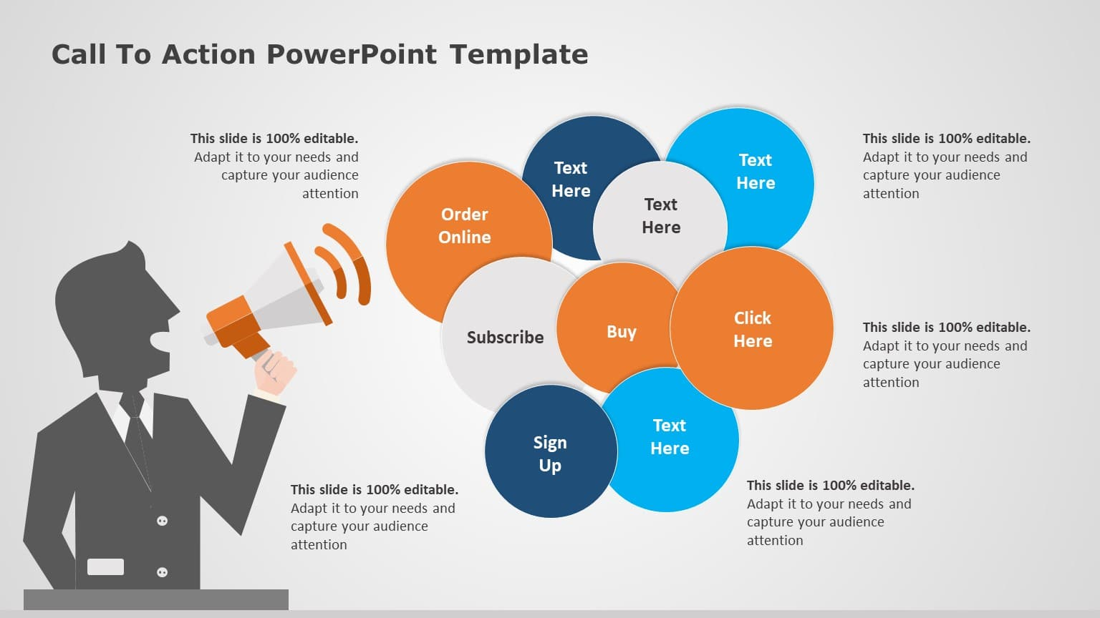
Include a Call to Action
Include a Call to Action
Notes:
Ensure there is a clear call to action, such as event information or a contact point.
Design the call to action with high prominence in the design.

Slide 12
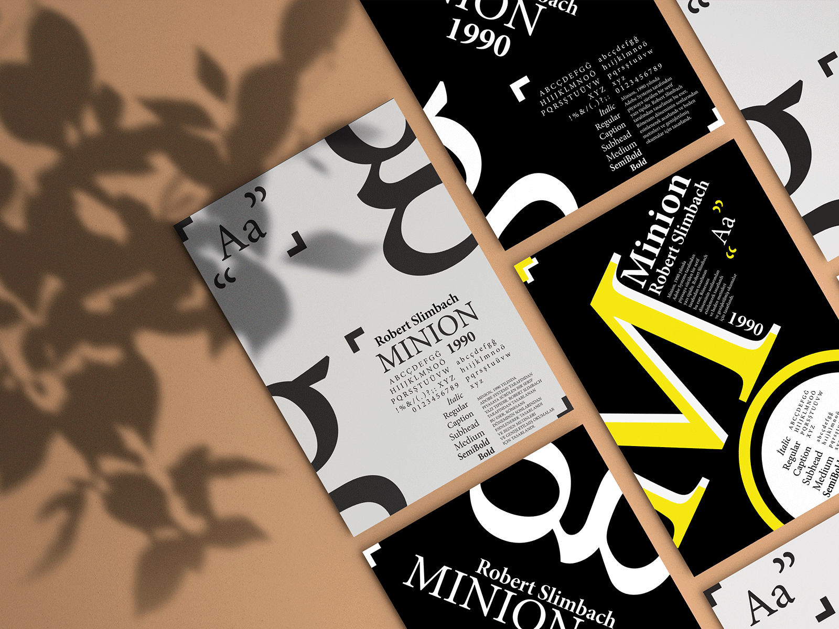
Create Focus with Typography
Notes:
Use bold, wide, and large typefaces that set the tone for the project.
Experiment with typography, but maintain readability and appropriateness for the event.

Slide 13
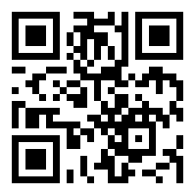
https://learn.codemithra.com

Slide 14
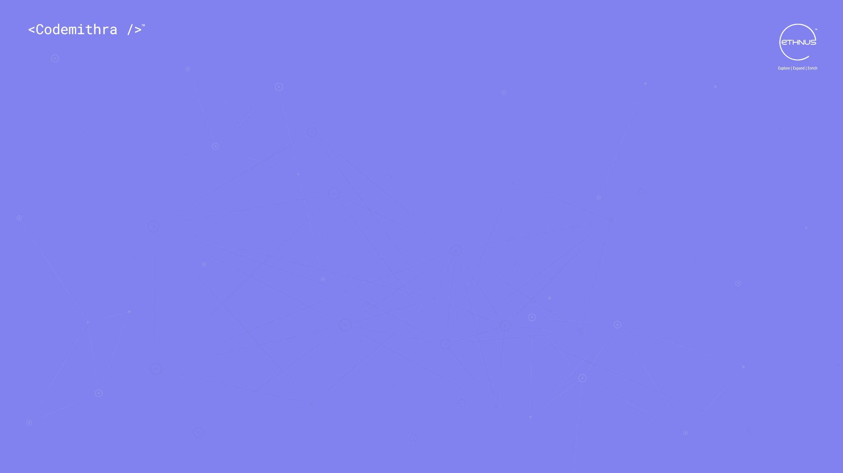



THANK YOU
+91 78150 95095
codemithra@ethnus.com
www.codemithra.com

